Slide 1
WALMART SUPERSTORE SALES ANALYSIS
Presented by,
Krishna Prasath V

Slide 2
About Walmart
Walmart is a multinational retail corporation headquartered in Bentonville, Arkansas, United States. Founded in 1962 by Sam Walton, Walmart operates a chain of hypermarkets, discount department stores, and grocery stores. It is one of the world's largest companies by revenue and employs over two million people worldwide.

Slide 3
Comparison with Amazon
Business Model:
Walmart: Primarily operates physical retail stores with an expanding online presence. Known for its extensive network of stores offering a wide range of products at low prices.
Amazon: Initially an online marketplace, Amazon has diversified into various sectors including e-commerce, cloud computing, digital streaming, and artificial intelligence. It focuses on delivering convenience and a vast selection of products to customers globally.

Slide 4
Distribution and Fulfillment:
Walmart: Utilizes a network of physical stores for product distribution and offers services like click-and-collect and same-day delivery through its stores.
Amazon: Known for its advanced fulfillment network, including fulfillment centers, sortation centers, and delivery stations. Offers various delivery options like Prime, Prime Now, and Amazon Fresh.

Slide 5
Customer Base:
Walmart: Appeals to a broad customer base, including budget-conscious shoppers and those preferring in-store shopping experiences.
Amazon: Attracts a diverse customer base, including those seeking convenience, fast shipping, and a vast selection of products. It has a significant presence among tech-savvy and urban consumers.

Slide 6
Technology and Innovation:
Walmart: Has invested in technology to improve its supply chain, inventory management, and online platforms. Introduced services like Walmart+ for subscription-based benefits.
Amazon: Renowned for its innovation in logistics, artificial intelligence (AI), and customer-centric technology. Continuously introduce new services and features like Amazon Prime, Alexa, and Amazon Go stores.

Slide 7
Competitive Strategies:
Walmart: Focuses on offering everyday low prices, leveraging its extensive physical presence, and expanding its e-commerce capabilities to compete with Amazon.
Amazon: Emphasizes customer experience, innovation, and diversification into new markets. Prioritizes long-term growth over short-term profitability.

Slide 8
Competitive Strategies:
Walmart: Focuses on offering everyday low prices, leveraging its extensive physical presence, and expanding its e-commerce capabilities to compete with Amazon.
Amazon: Emphasizes customer experience, innovation, and diversification into new markets. Prioritizes long-term growth over short-term profitability.
Overall, while Walmart and Amazon both compete in the retail sector, they have distinct business models, strengths, and strategies, making them formidable competitors in the global marketplace.

Slide 9
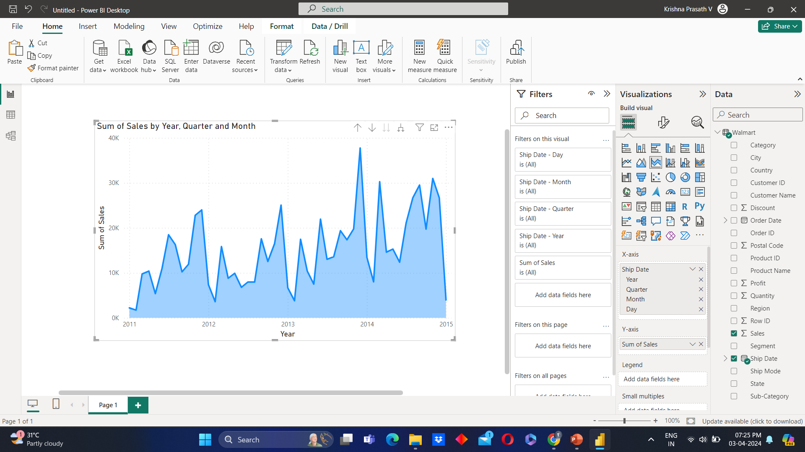
Highest sales in year-wise

Slide 10
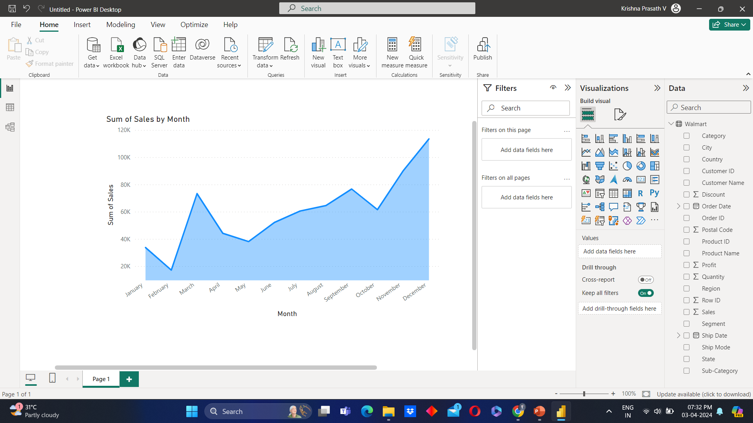
Highest sales in month wise

Slide 11
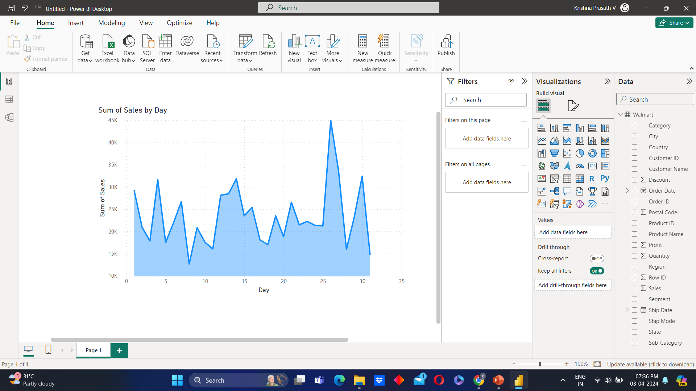
Highest sales in day wise

Slide 12
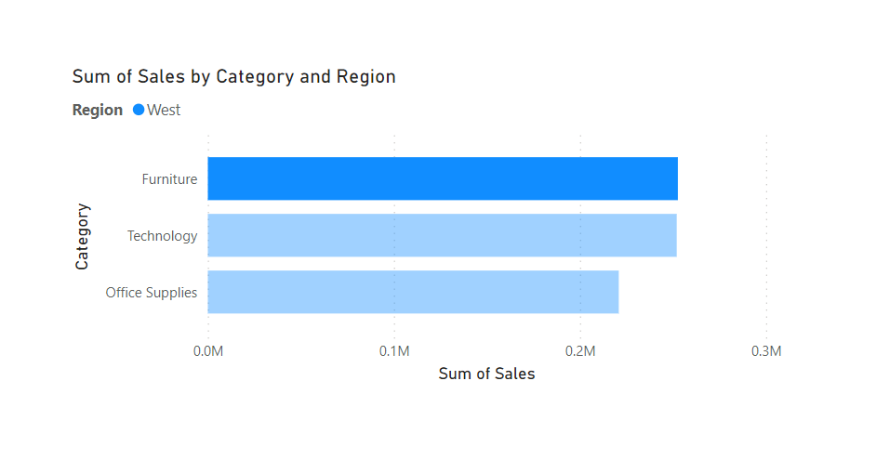
Highest and lowest sales

Slide 13
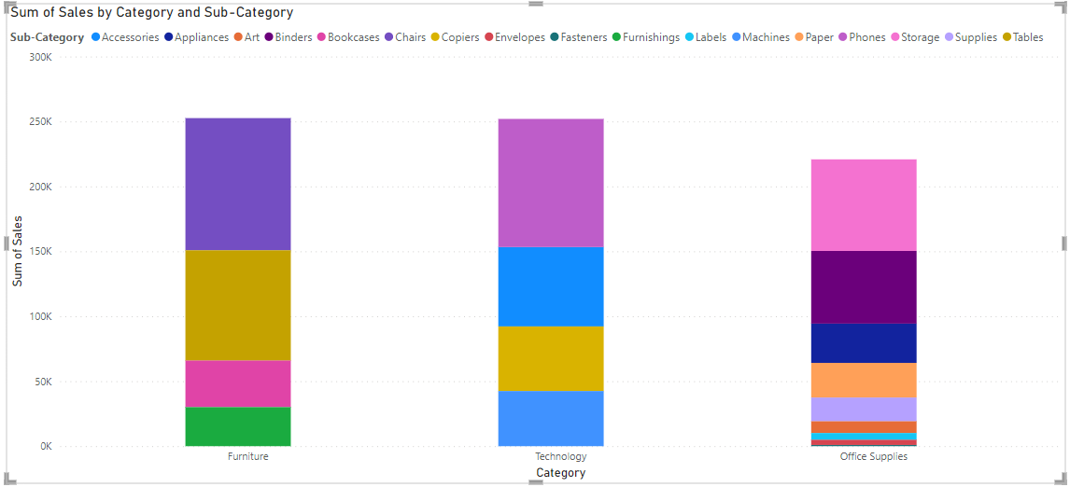
Which products were sold low?

Slide 14
Reference
git@github.com:Krishnaprasath693/Krishna-Prasath-V_Capstone-Project-1.git

Slide 15
Thank you

